Slide 1
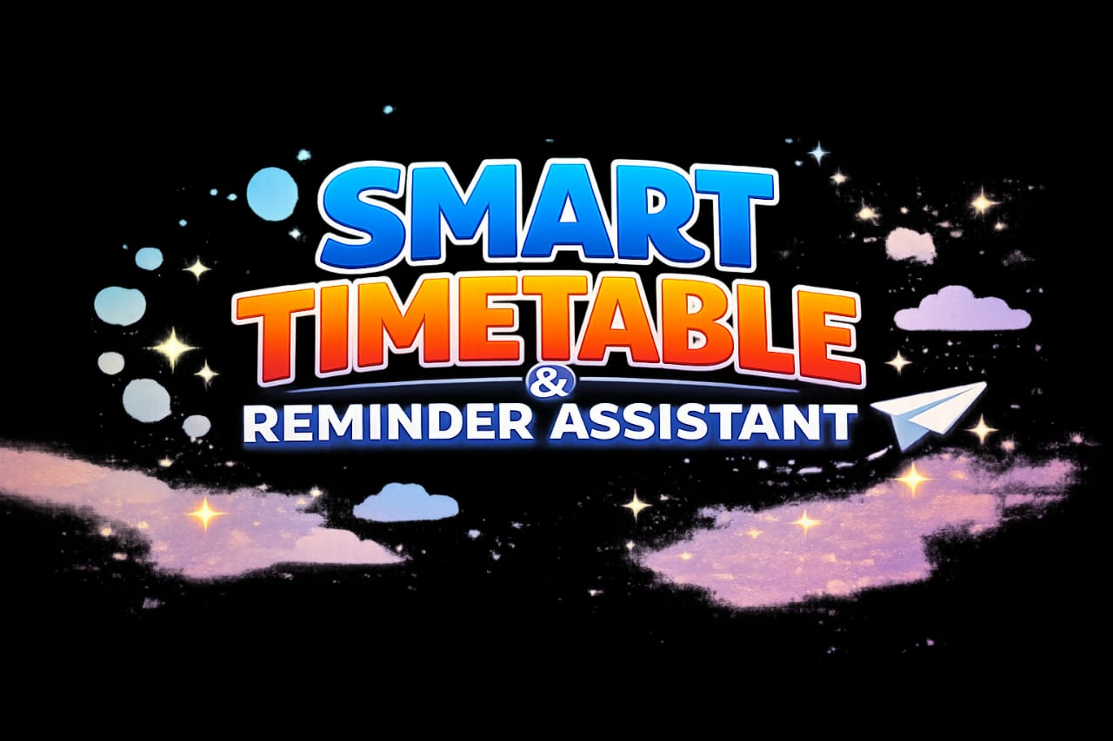
TEAM NAME: TEAM TECHNO

Slide 2
PROBLEM STATEMENT
Students and professionals struggle with:
Managing multiple tasks and deadlines
Forgetting important events or classes
Inefficient manual scheduling
Need for a *smart, automated assistant* to reduce stress and improve productivity.

Slide 3
SOLUTION OVERVIEW
A “Smart Timetable & Reminder Assistant” that:
Auto-generates schedules based on priorities
Sends reminders for tasks, classes, and deadlines
Adapts dynamically to changes
We developed a Smart Timetable & Reminder Assistant that:
Takes user input
Automatically generates study timetable
Add breaks
Shows Reminders

Slide 4
KEY FEATURES
📅 Smart Timetable Generation
🔔 Reminders & Alerts
🔄 Dynamic Rescheduling
🎯 Goal Setting & Deadline Tracking

Slide 5
SYSTEM ARCHITECTURE
Frontend (User Interface):
• Stream lit (Python)
Development Tool:
• Visual Studio Code (VS Code)
Libraries Used:
• stream lit
• datetime

Slide 6
LIVE DEMO & PROJECT LINKS
Live Website:
http://localhost:8501
GitHub Repository:
https://github.com/25eg112b56-crypto/Smart-Timetable-Reminder-.git

Slide 7
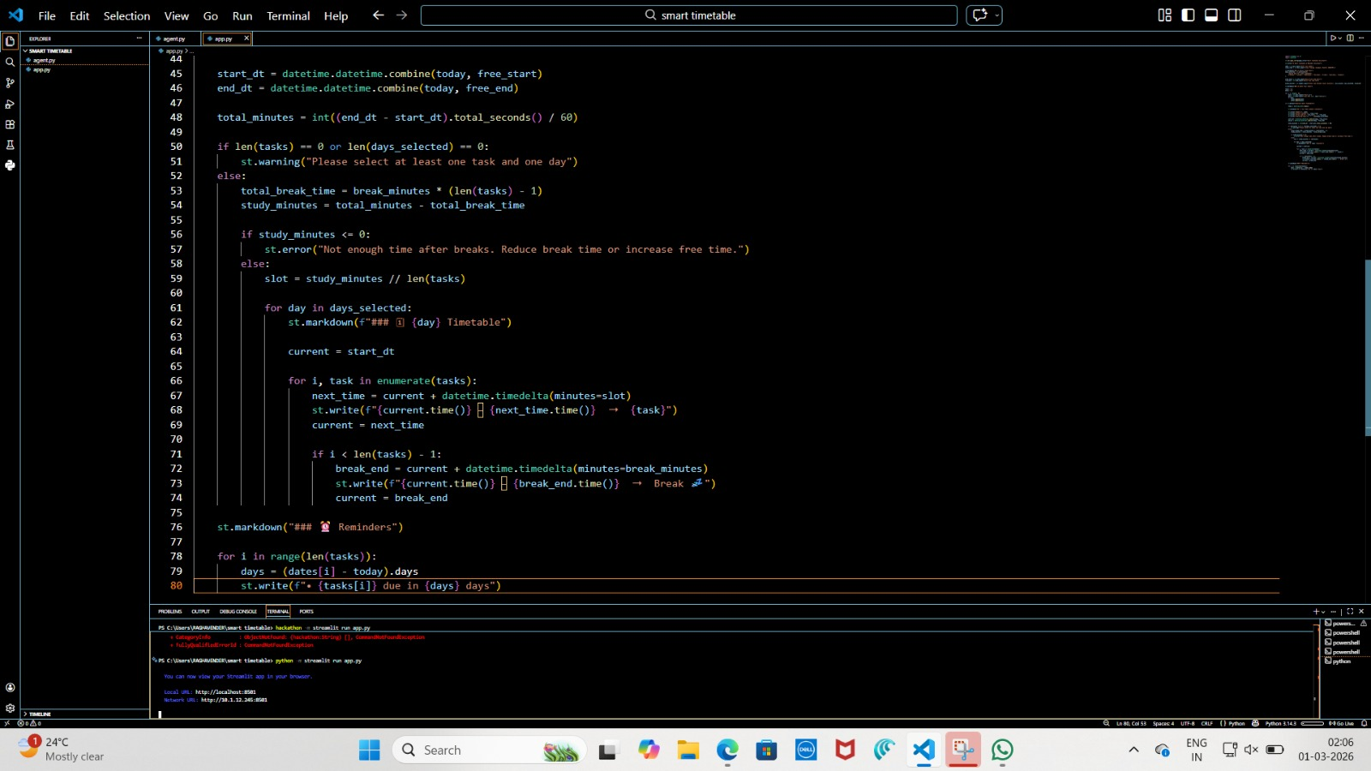

Slide 8
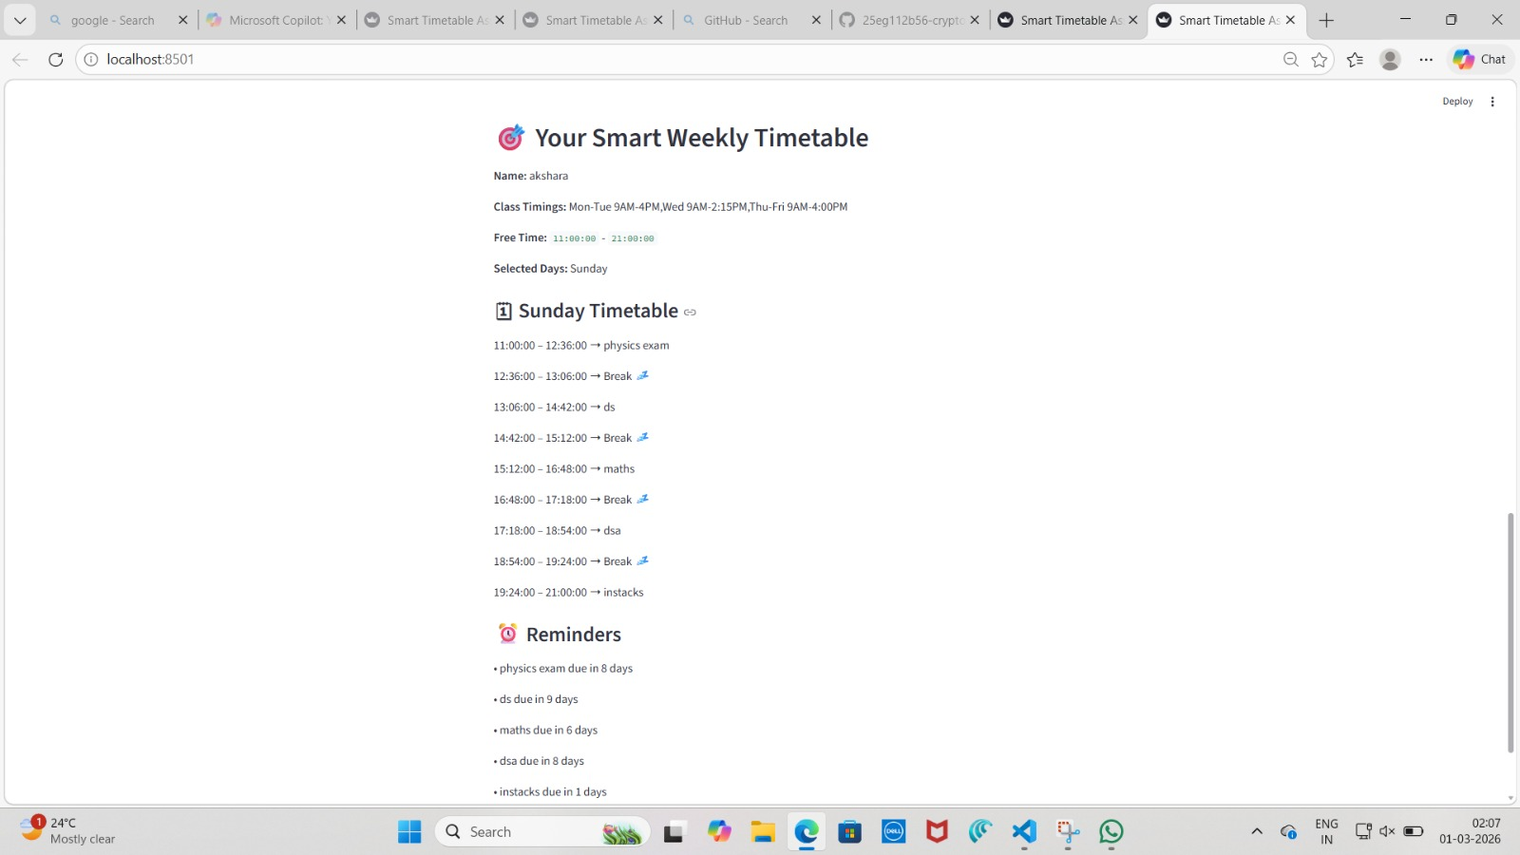

Slide 9
BENEFITS
Saves time ⏱️
Reduces stress 😌
Improves productivity 📈
Easy to use & accessible anywhere 🌍
Integrated Reminders🔔

Slide 10
THANKYOU

